Slide 1
Web Analytics
Presented By : Kavish Tyagi

Slide 2
Analytics done on a Website
Basic Reporting
Campaign & Conversion Tracking
Data collection & Configuration
Analysis Tools & Techniques

Slide 3
Basic Reporting
Audience Reports
Acquisitions Reports
Behavior Report
Some of the most useful reports in Web Analytics are Audience reports, which offer information about the users visiting website.
Acquisition reports can provide insight about how users get to your website, and how well your digital marketing and advertising works across different channels like email, search, and display ads. These are some of the most important and actionable reports.
Behavior reports show how users interact with website. This can include many different things from what content users view to how users navigate between pages.

Slide 4

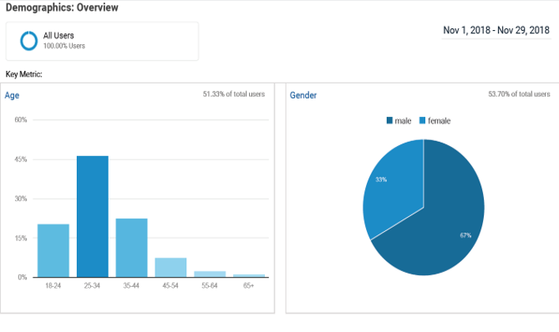
AUDIENCE REPORT
Demographic Overview
Custom Time Frame
Distribution of Users by "Age" and "Gender".

Slide 5
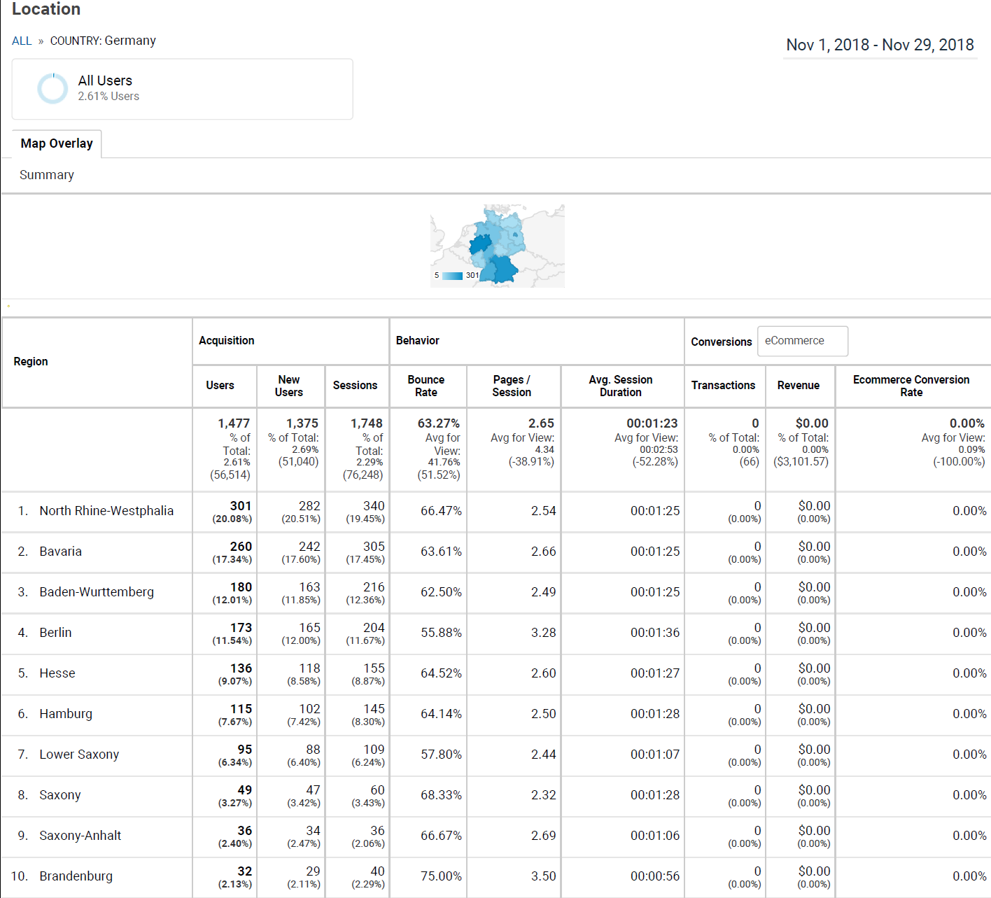
AUDIENCE REPORT
Geo Location
Custom Time Frame
Distribution over geo location.

Slide 6
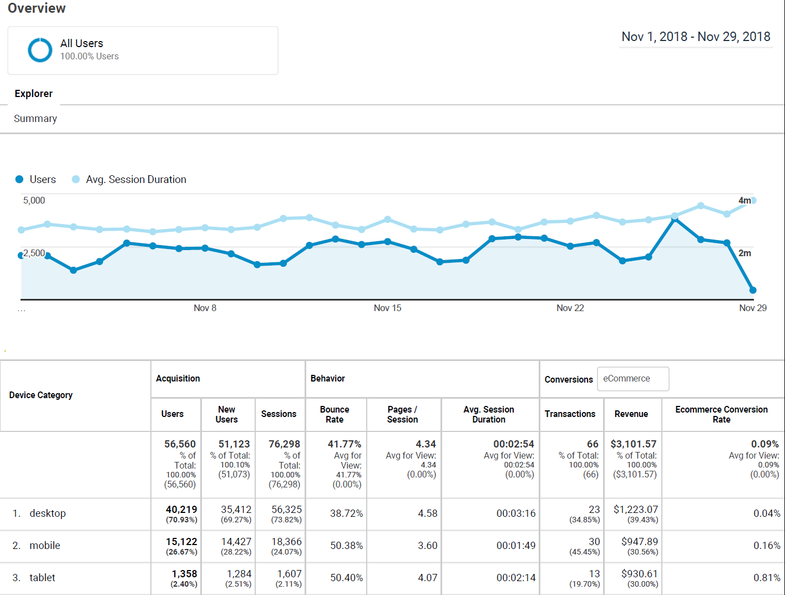
AUDIENCE REPORT
Device Report
Custom Time Frame
Distribution of number of users vs Average session duration.

Slide 7
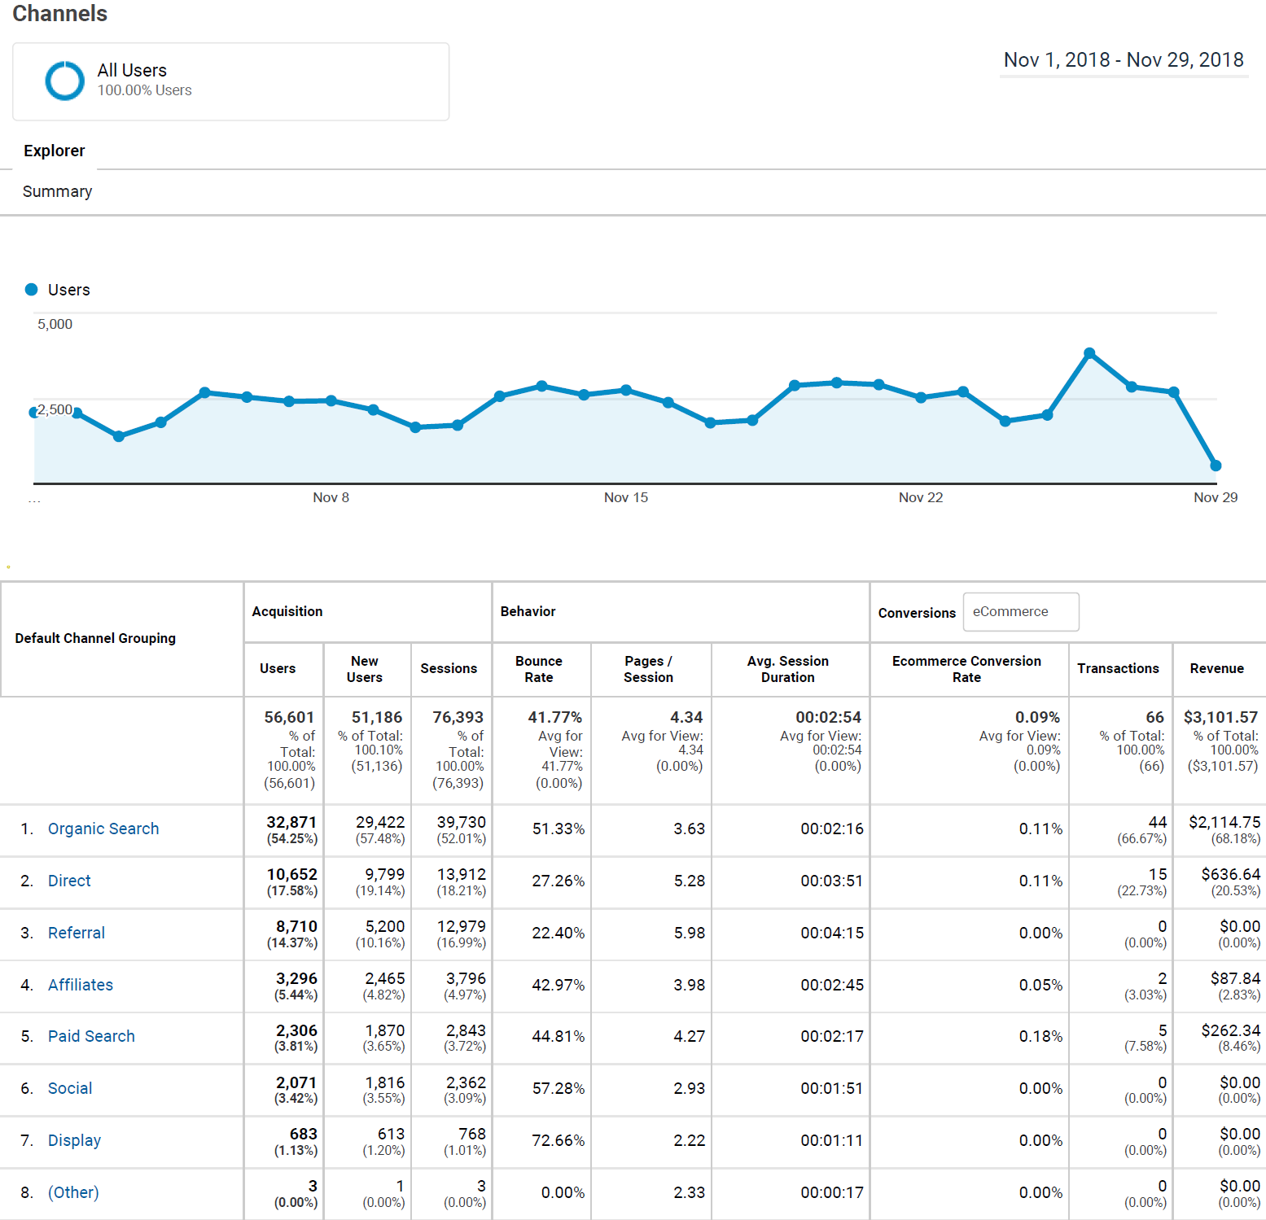
ACQUISITION REPORT
Channel Report
Custom Time Frame
Distribution of user over various channel of acquisition.

Slide 8
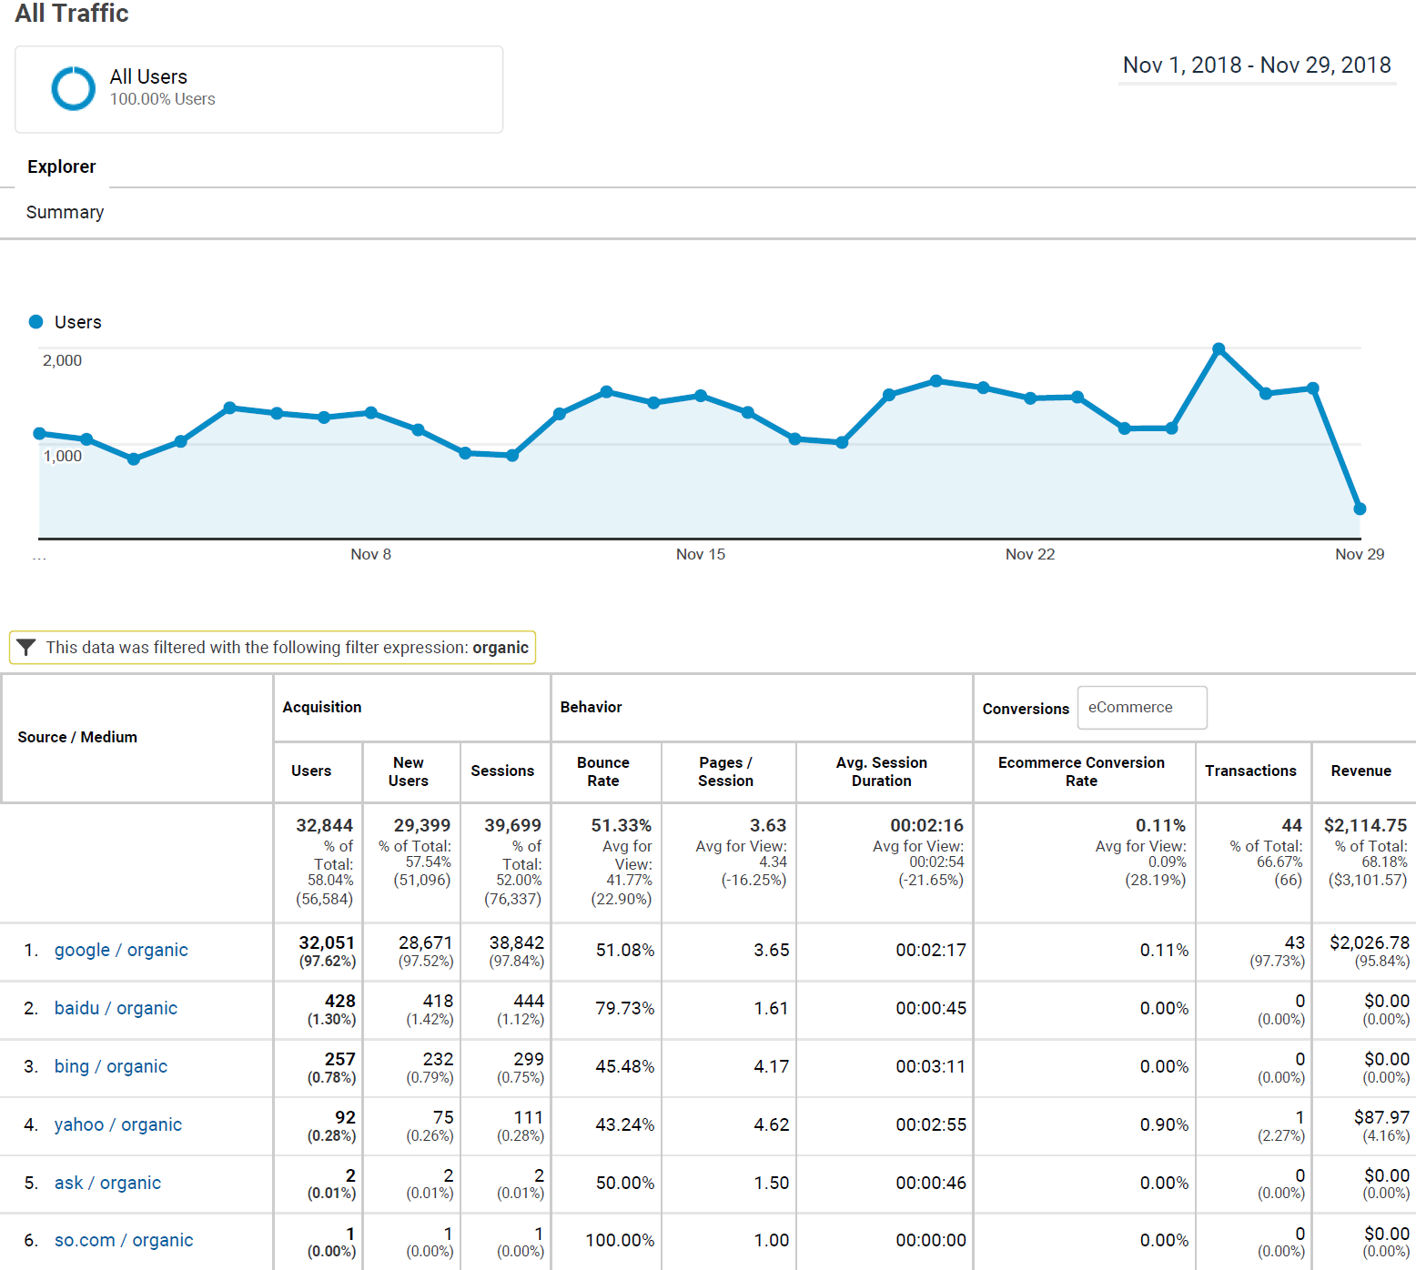
ACQUITISION REPORT
Customized traffic report
Custom Time Frame
Distribution of users who are specifically Organic traffic.

Slide 9
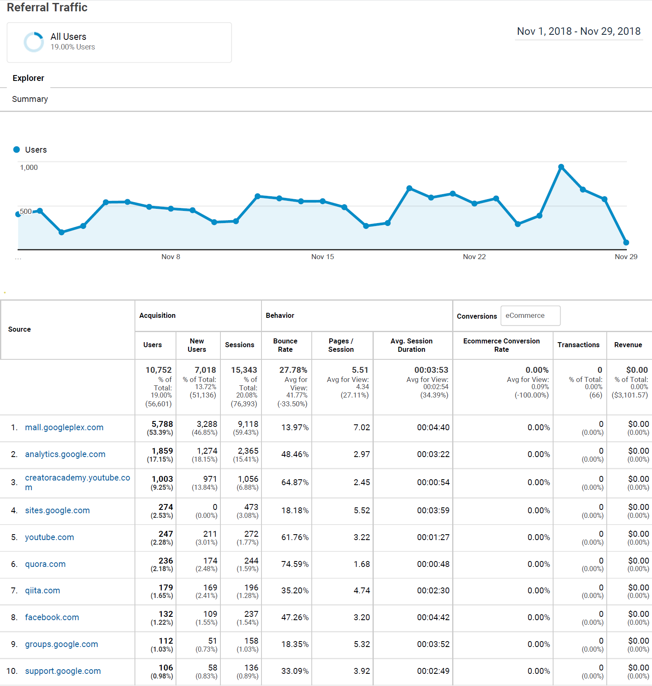
ACQUITISION REPORT
Referral traffic report
Custom Time Frame
Users acquisition through various sources.

Slide 10
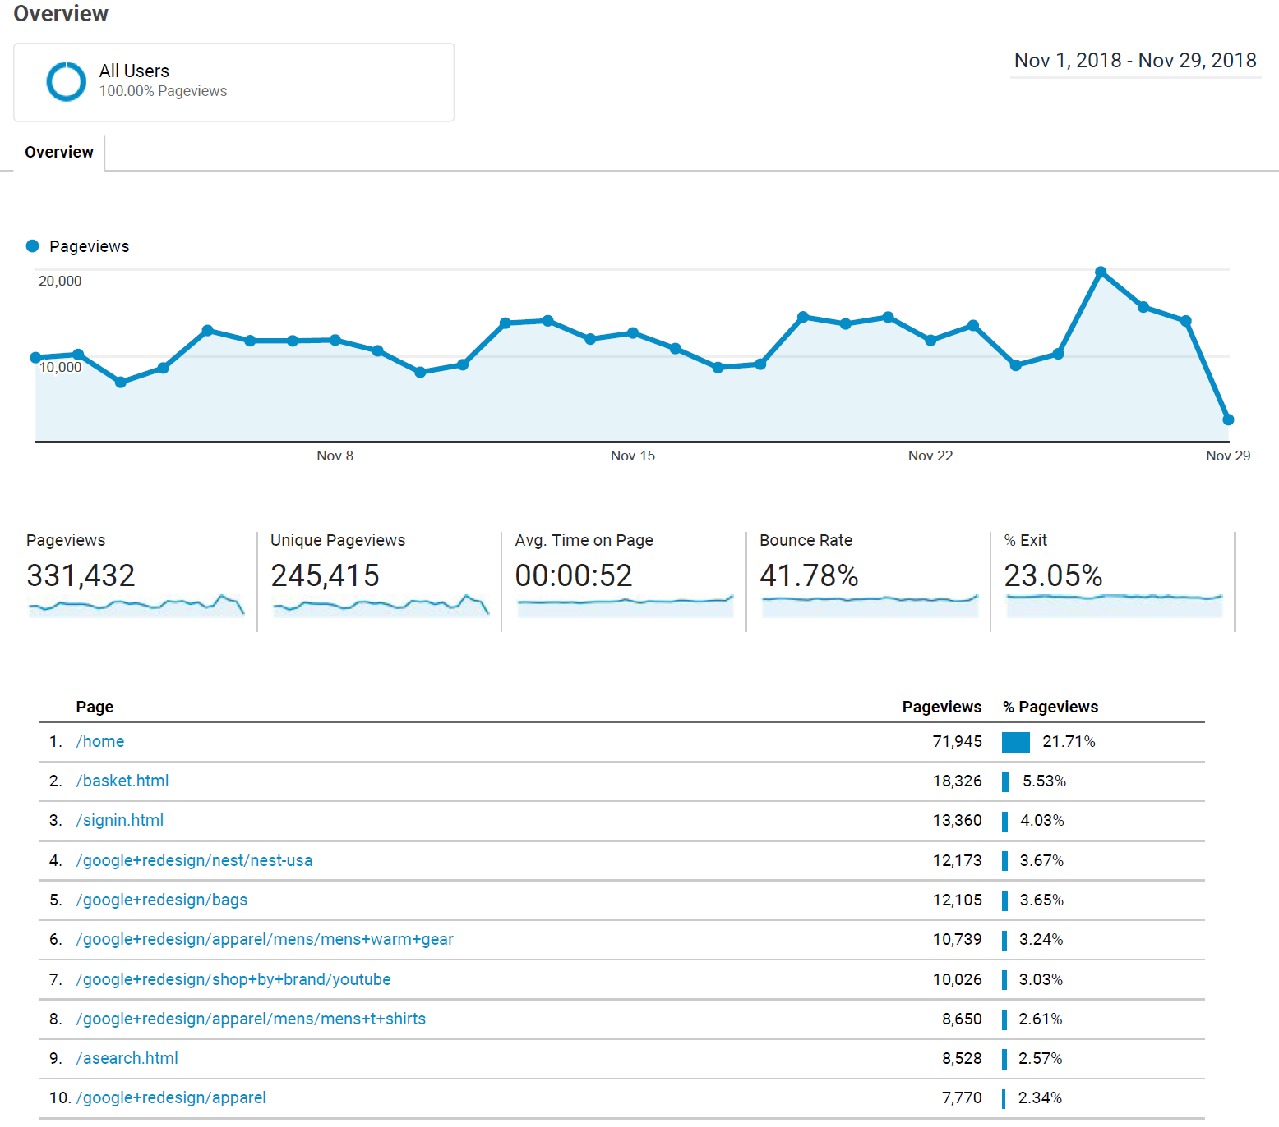
BEHAVIOR REPORT
Page view report
Custom Time Frame
Users pageview distribution on various pages.

Slide 11
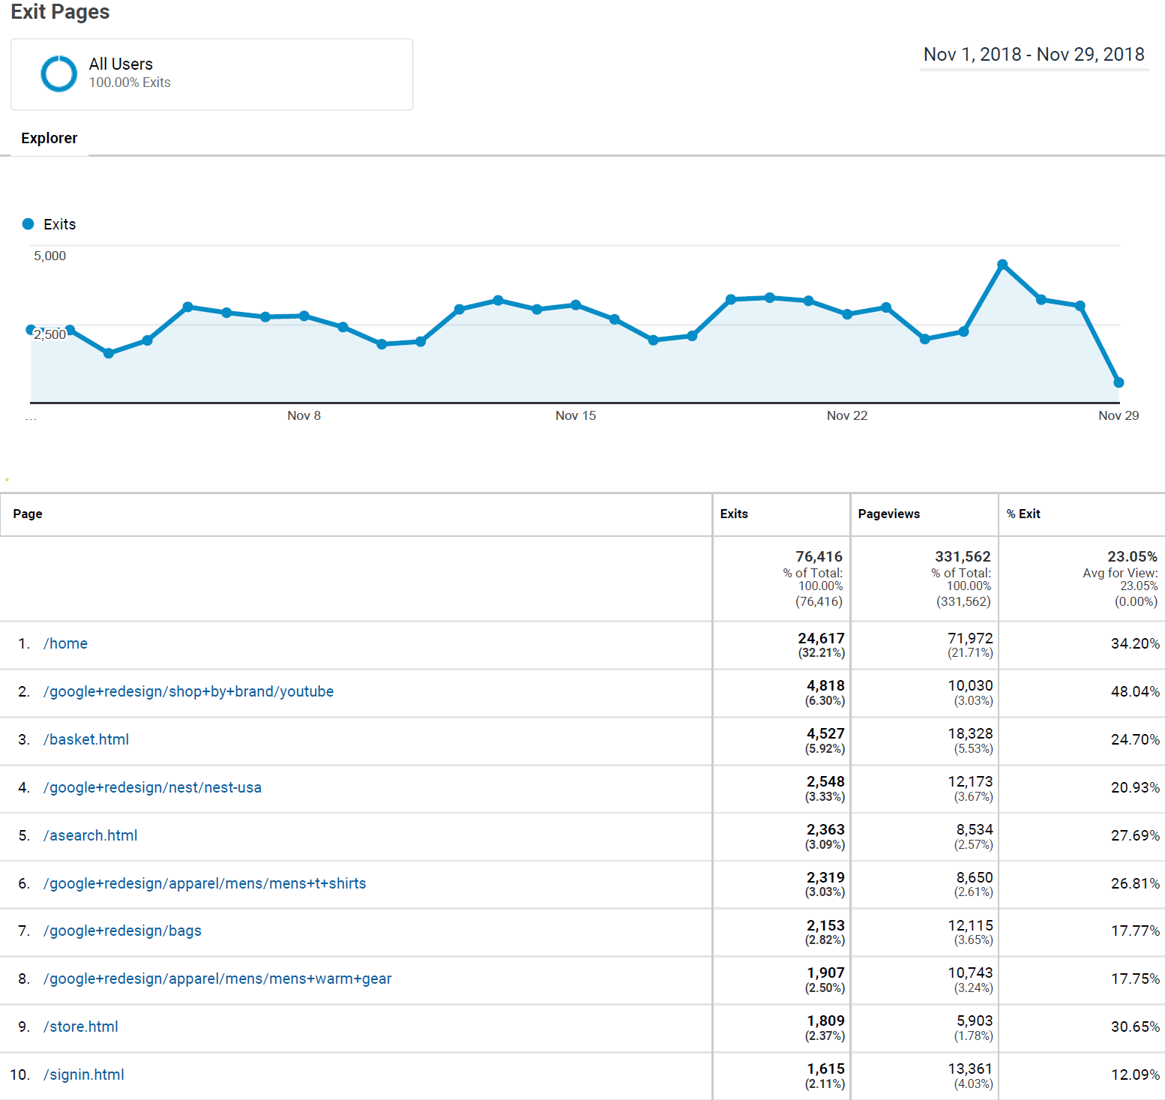
BEHAVIOR REPORT
Exit page report
Custom Time Frame
User's exit from different page source.

Slide 12
Campaign & Conversion Tracking
Ad campaigns can be an effective way to bring users to website and grow business. Web Analytics in an effective way to track marketing campaigns in Google Ads or other platforms can substantially grow business.

Slide 13
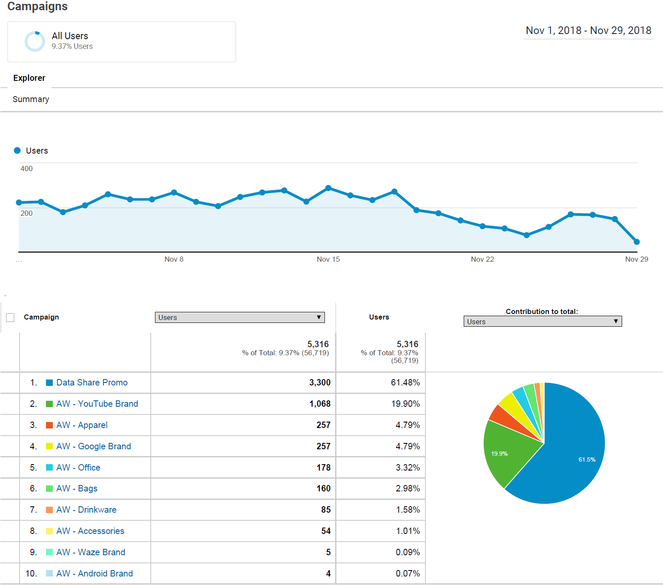
CAMPAIGN REPORT
Overview report
Custom Time Frame
User's acquisition from different ad campaigns.

Slide 14
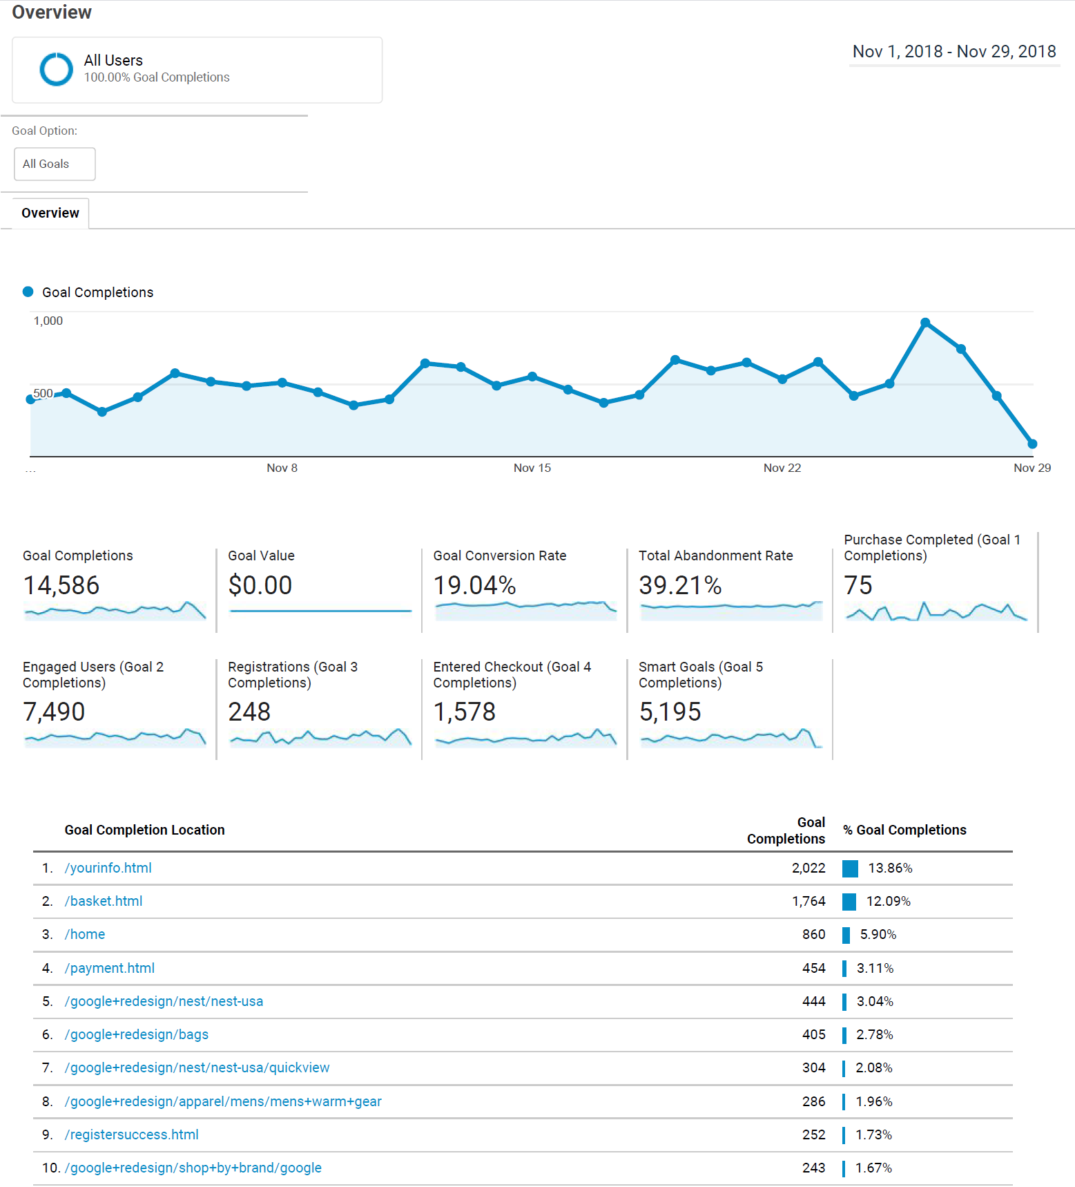
CONVERSION REPORT
Goal completion overview report.
Goal 1 is Purchases completed, Goal 2 is Engaged users, Goal 3 is registrations, Goal 4 is engaged users.
Custom Time Frame
Overview of goal completion location page on the website.

Slide 15
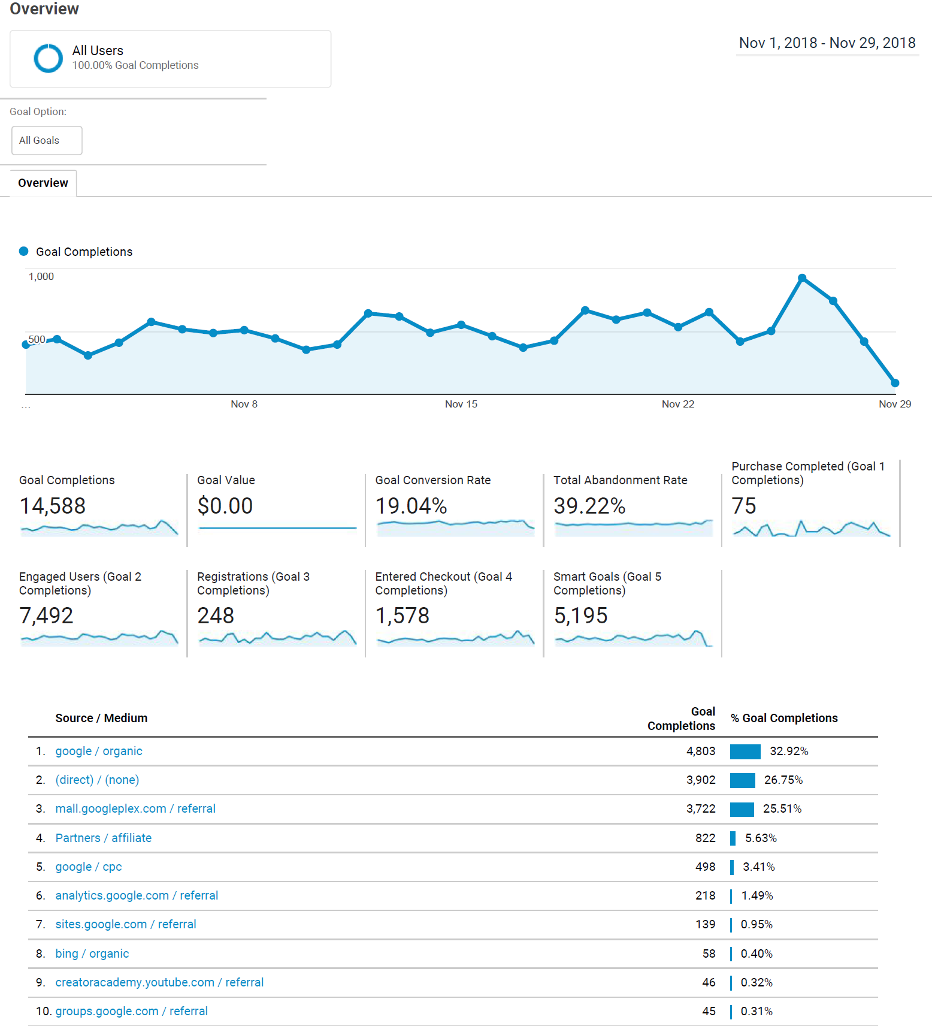
CONVERSION REPORT
Goal completion overview report.
Custom Time Frame
Overview of source and medium of various goal completions.

Slide 16
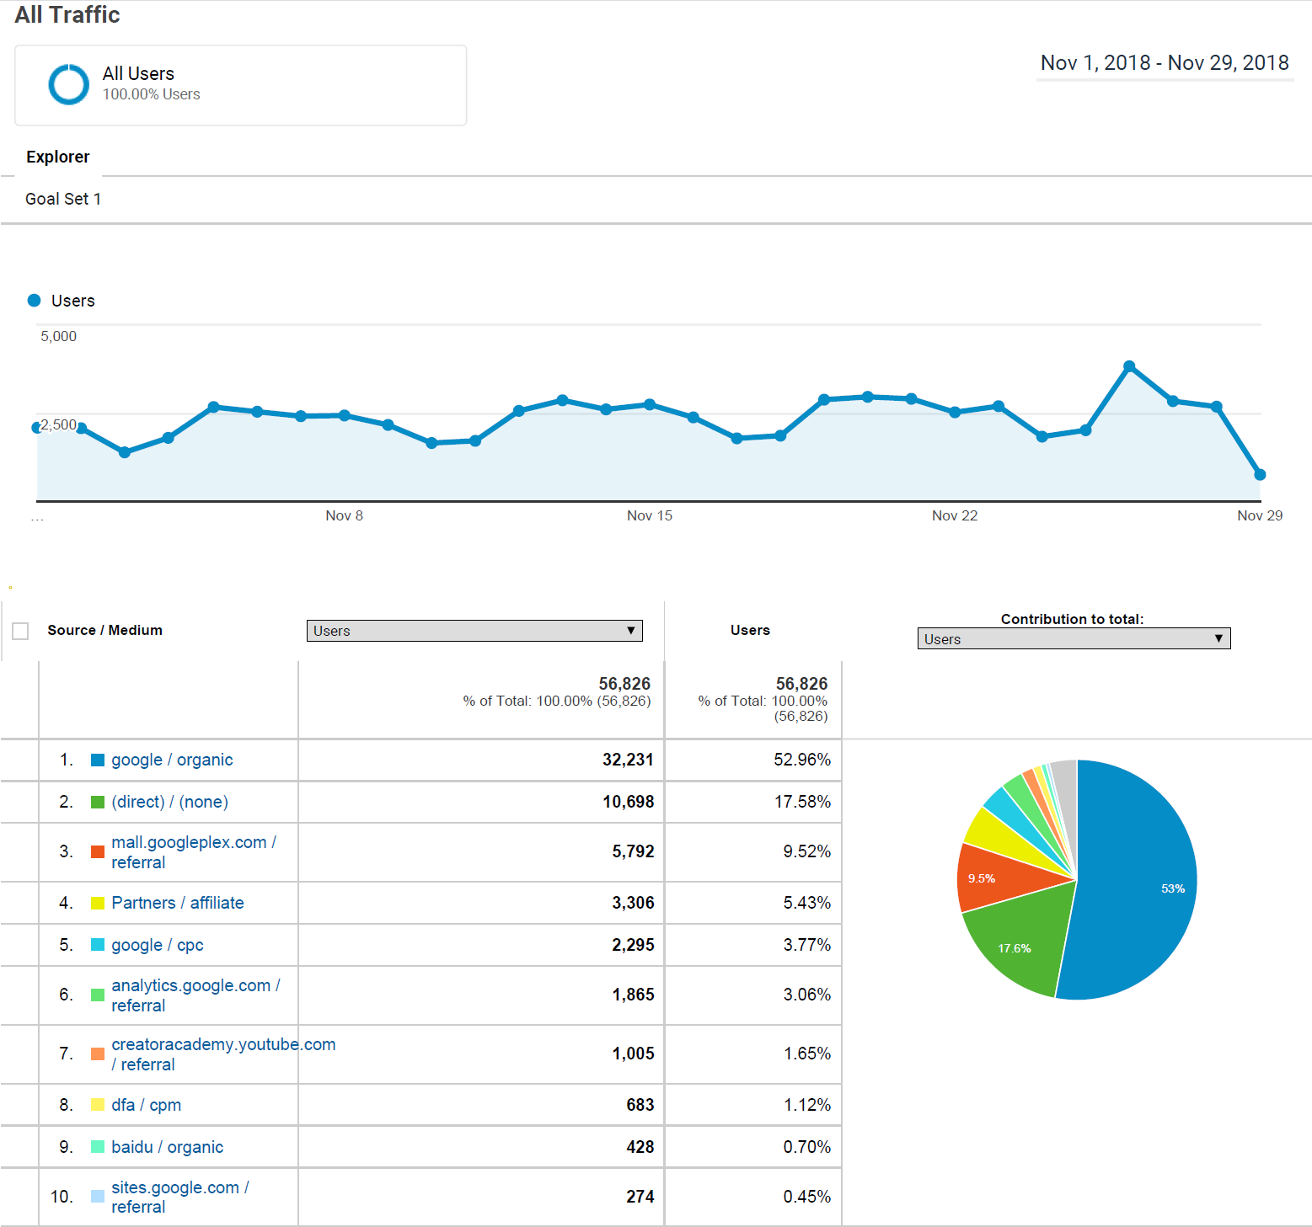
CONVERSION REPORT
Custom Traffic report based on goal i.e. Purchases Completed
Custom Time Frame
Traffic source and medium distribution of users on custom goal set.

Slide 17
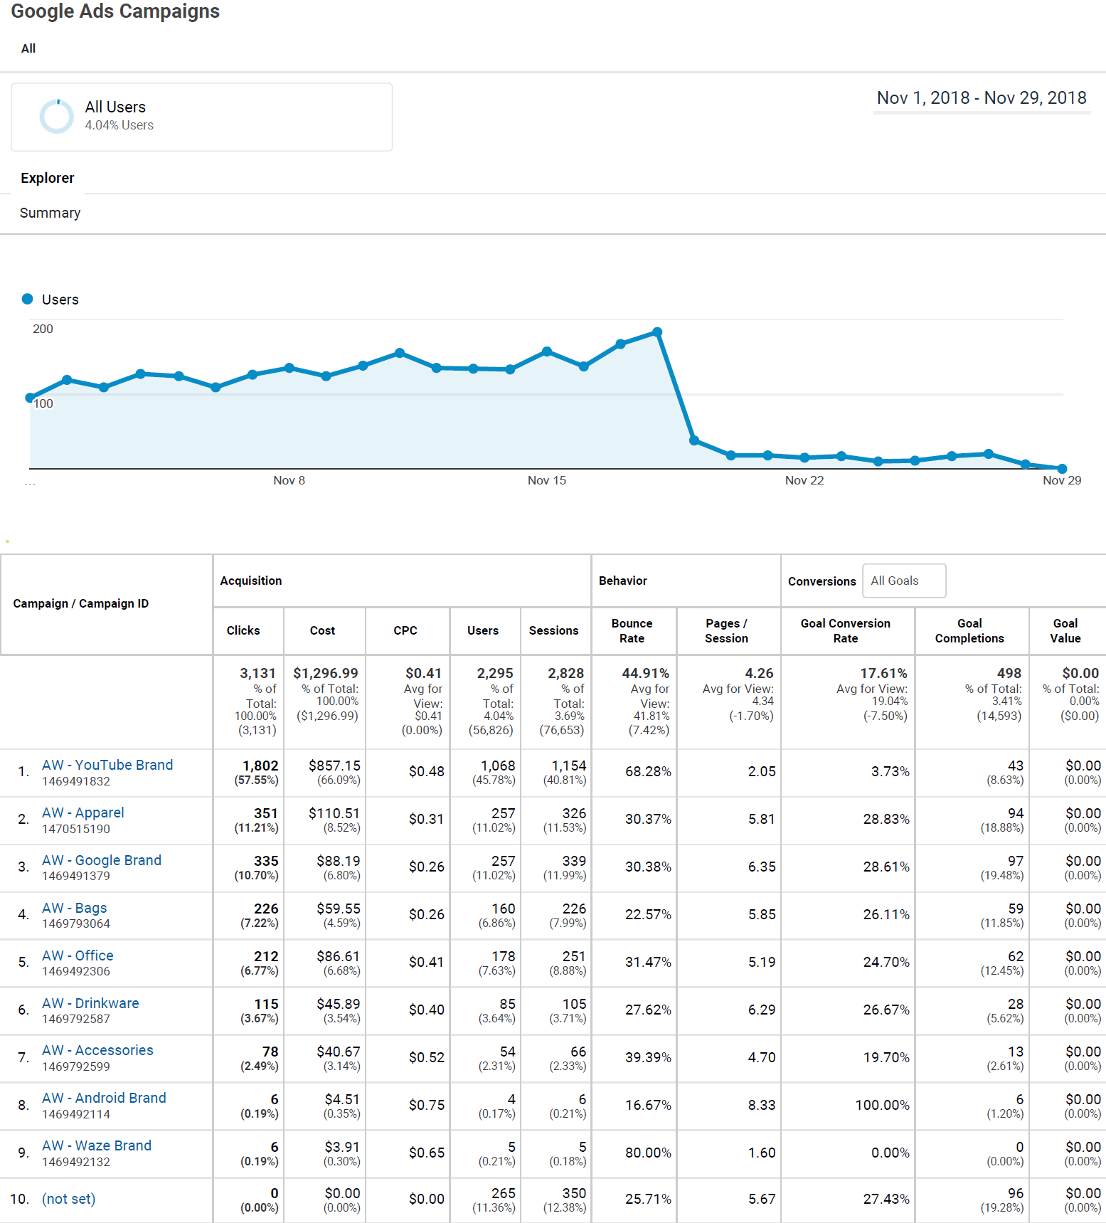
CAMPAIGN REPORT
Google ads campaign report.
Custom Time Frame
User acquisition based on custom google ad campaigns.

Slide 18
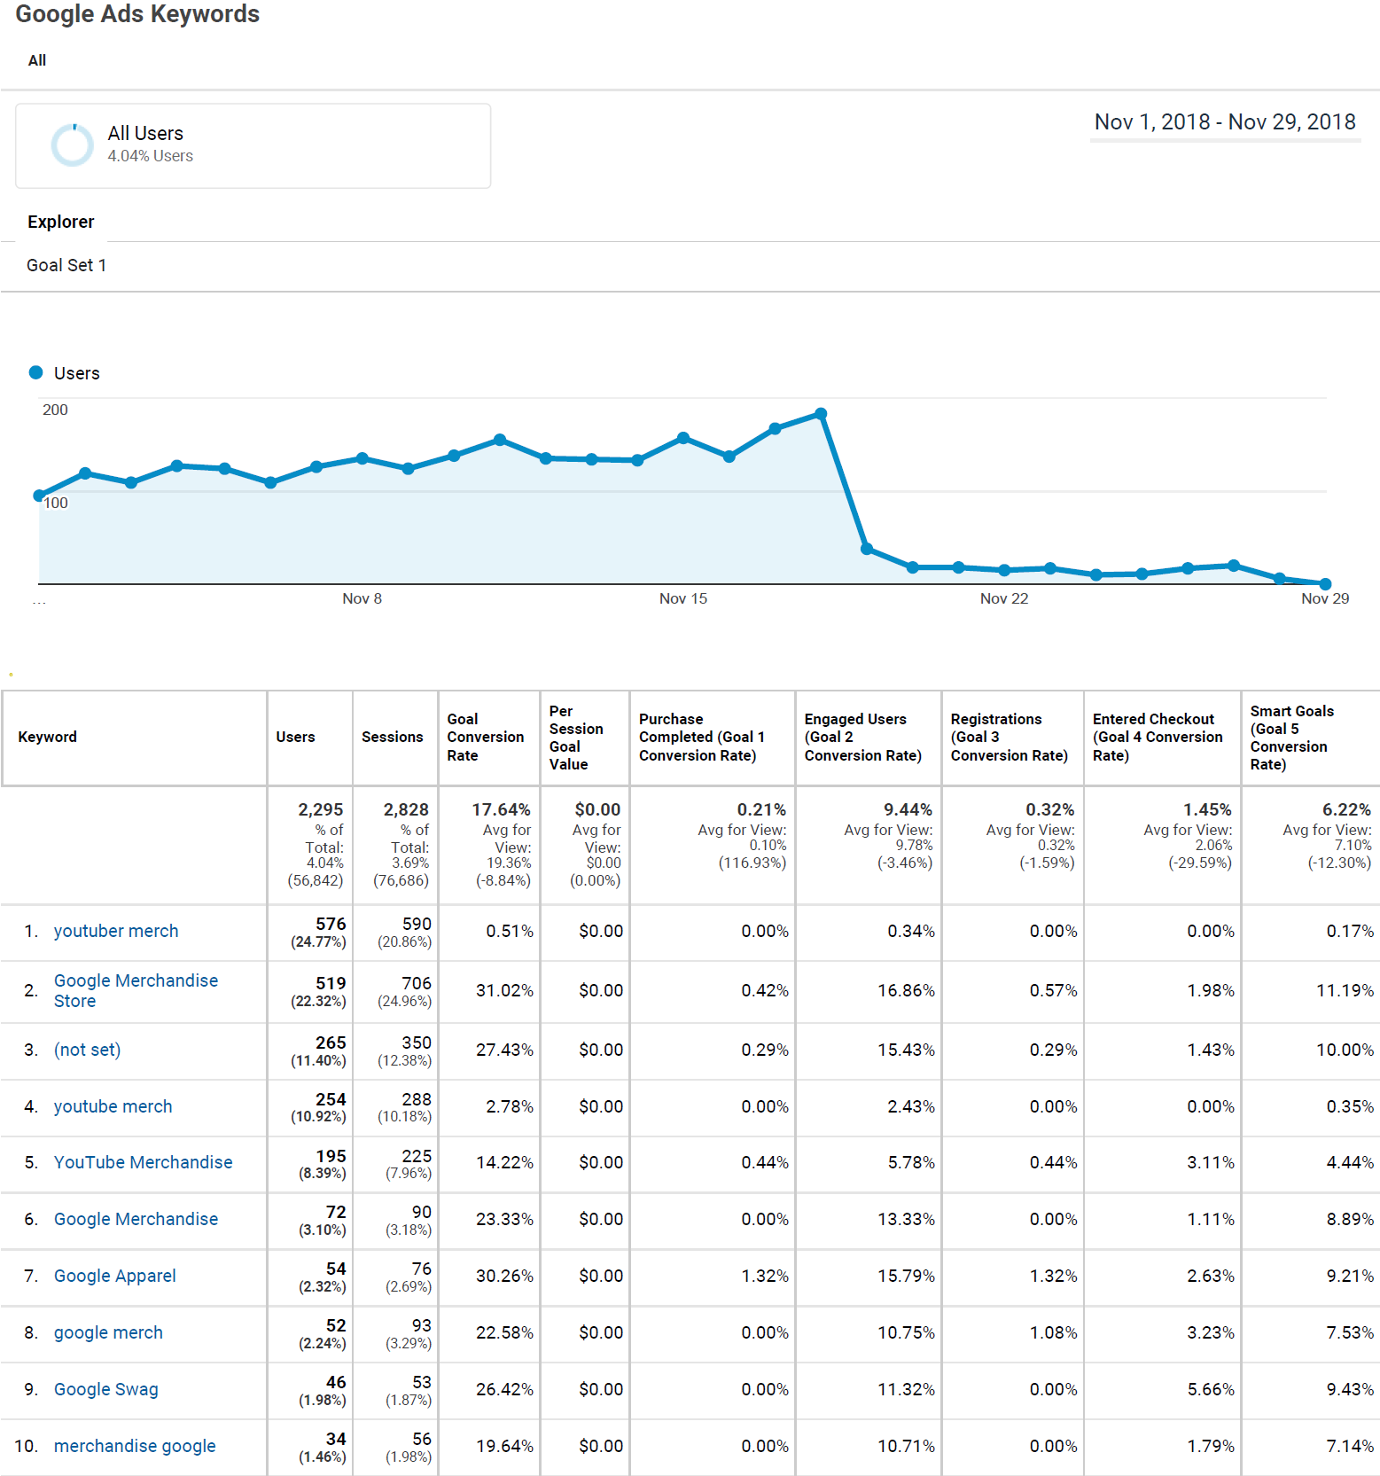
CAMPAIGN REPORT
Custom Google ads keyword report
Custom Time Frame
User acquisition through various keyword which are filtered over Goal set 1 i.e. Purchases Completed.

Slide 19
Data Collection & Configuration
Adding advanced filters to views lets further refine the data that is collected and can even transform how that data shows up in reports. Custom Dimensions are one of the most powerful configuration settings you can use to collect data that's specific to your business.

Slide 20
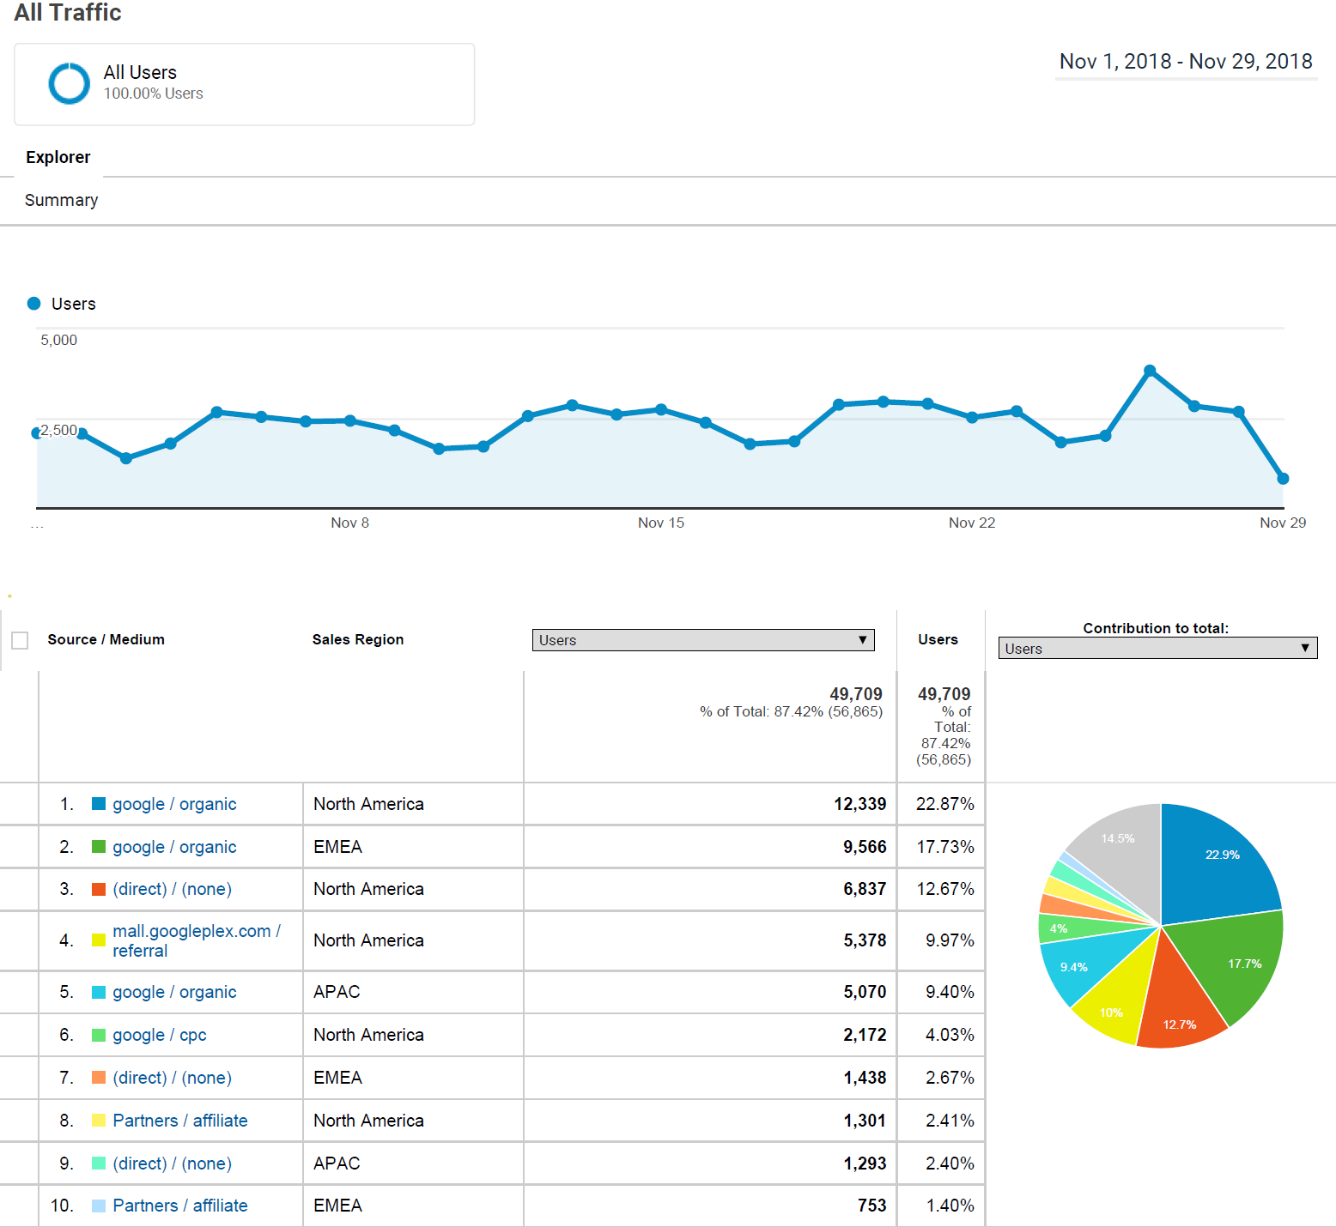
CUSTOM REPORT
Custom traffic report showing source and medium of acquisition.
Custom Time Frame
The report has been customized on the basis of sales region which has been added as a secondary dimension of filtering.

Slide 21
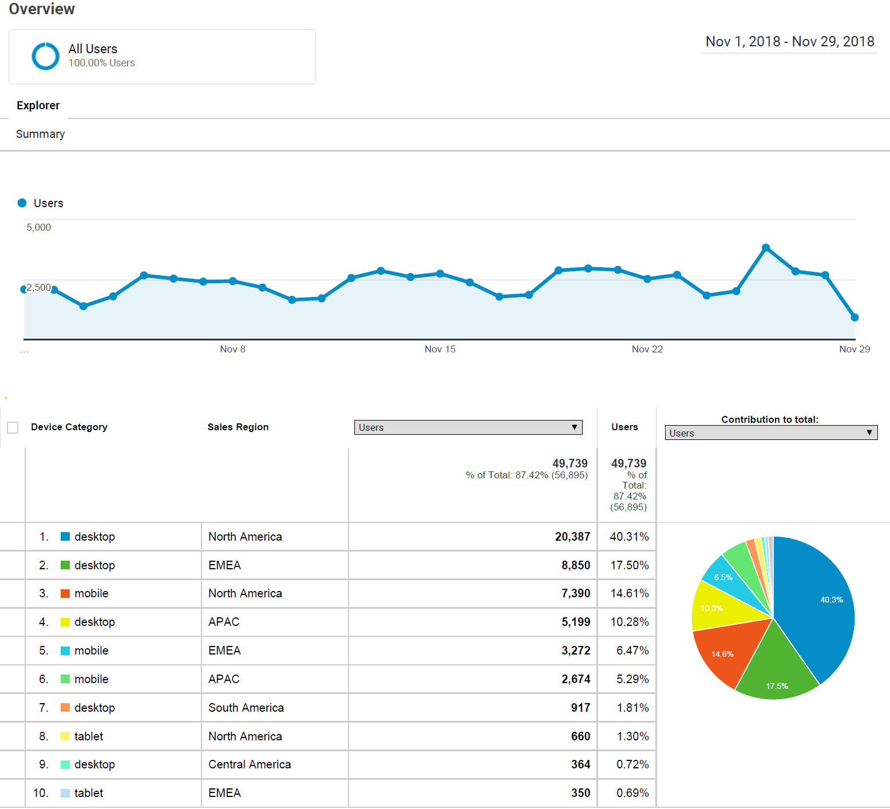
CUSTOM REPORT
Custom Device usage report
Custom Time Frame
The report has been customized on the basis of sales region which has been added as a secondary dimension of filtering.

Slide 22
Analysis Tools & Techniques
Segmentation is one of the most common ways to analyze subsets of data. Anaysis based on the channels help in understanding which channels brought in valuable traffic and led to conversions. Analysis based on the audienece help in better understand the characteristics of your customers, so you can better target your marketing

Slide 23
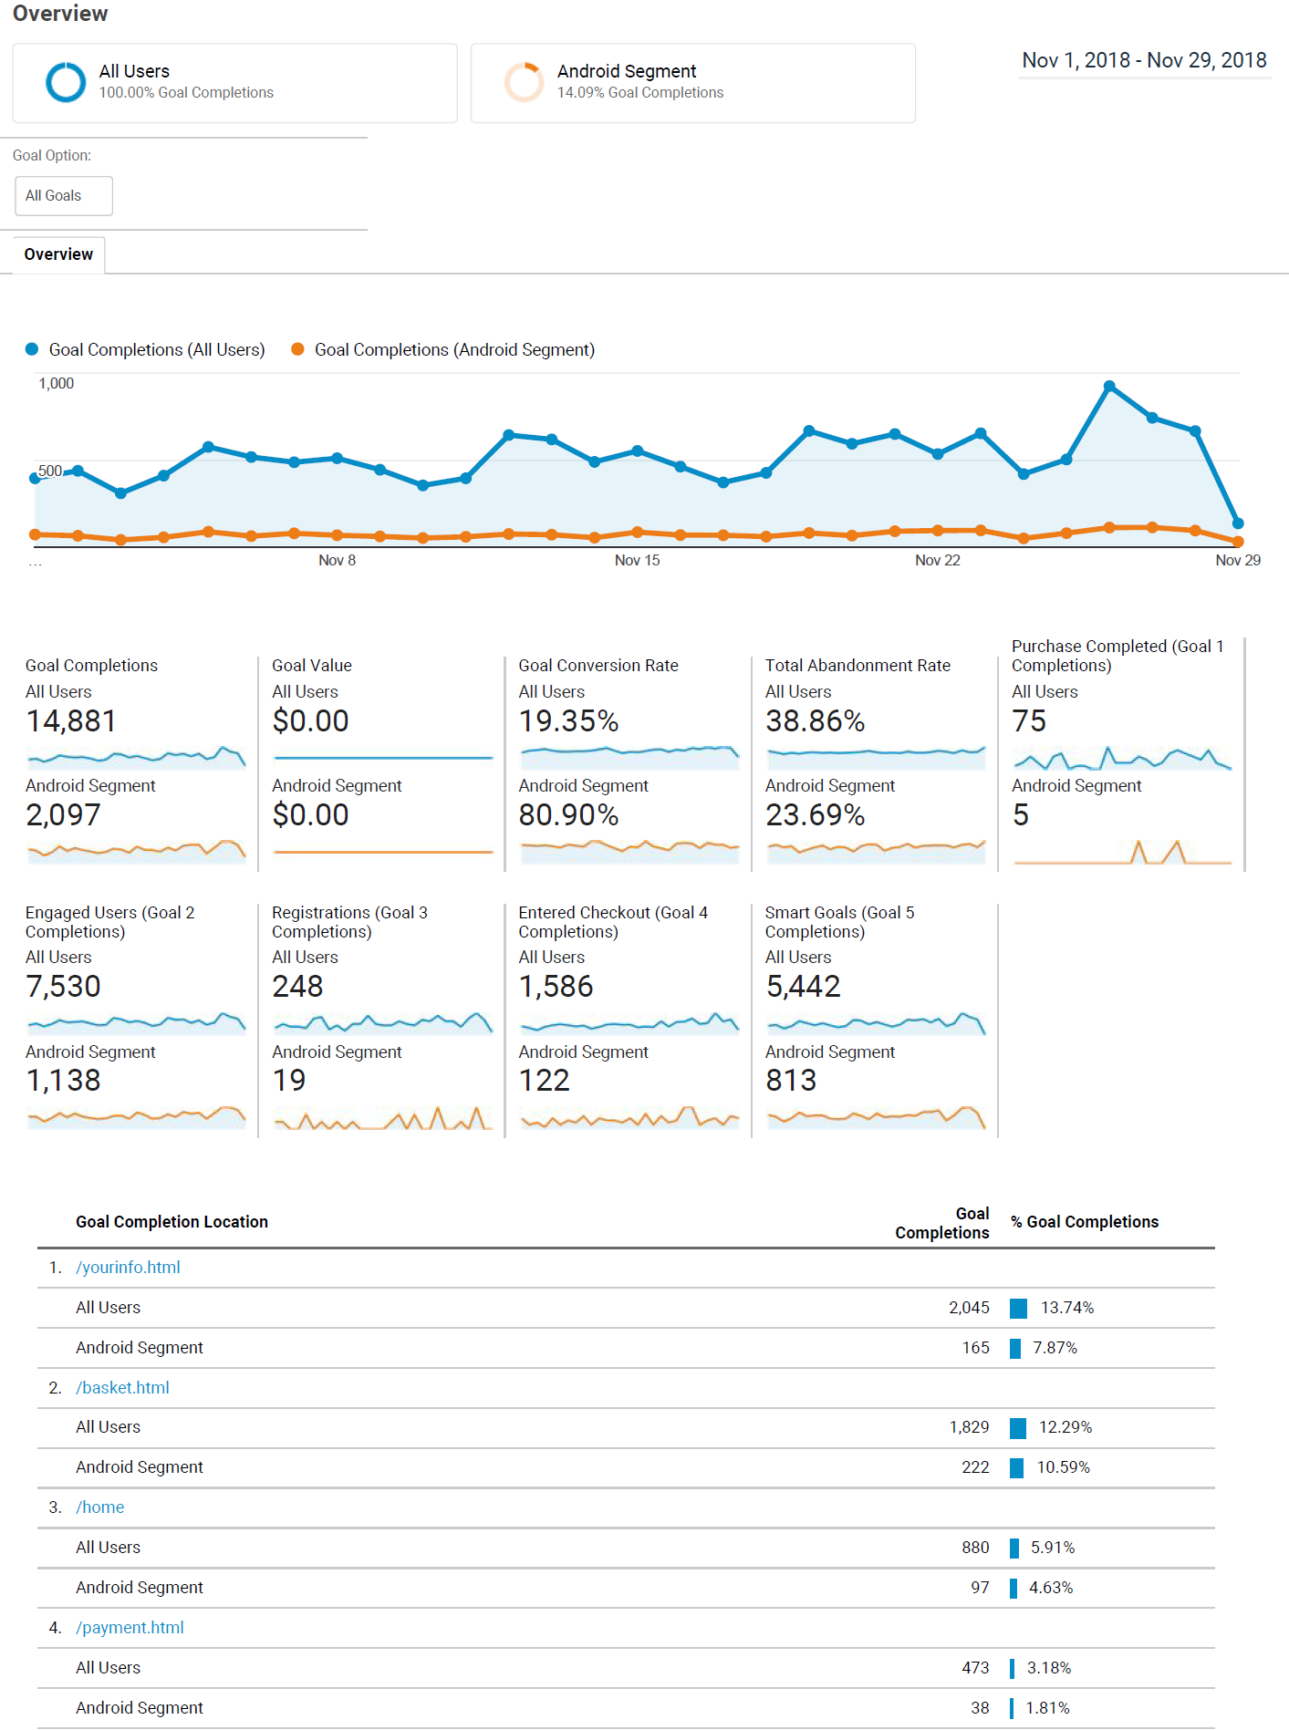
CAMPAIGN REPORT
Custom Goals overview report
Goals Overview report with a Custom Segment for sessions in which users visited a page with "Android" in the title.

Slide 24
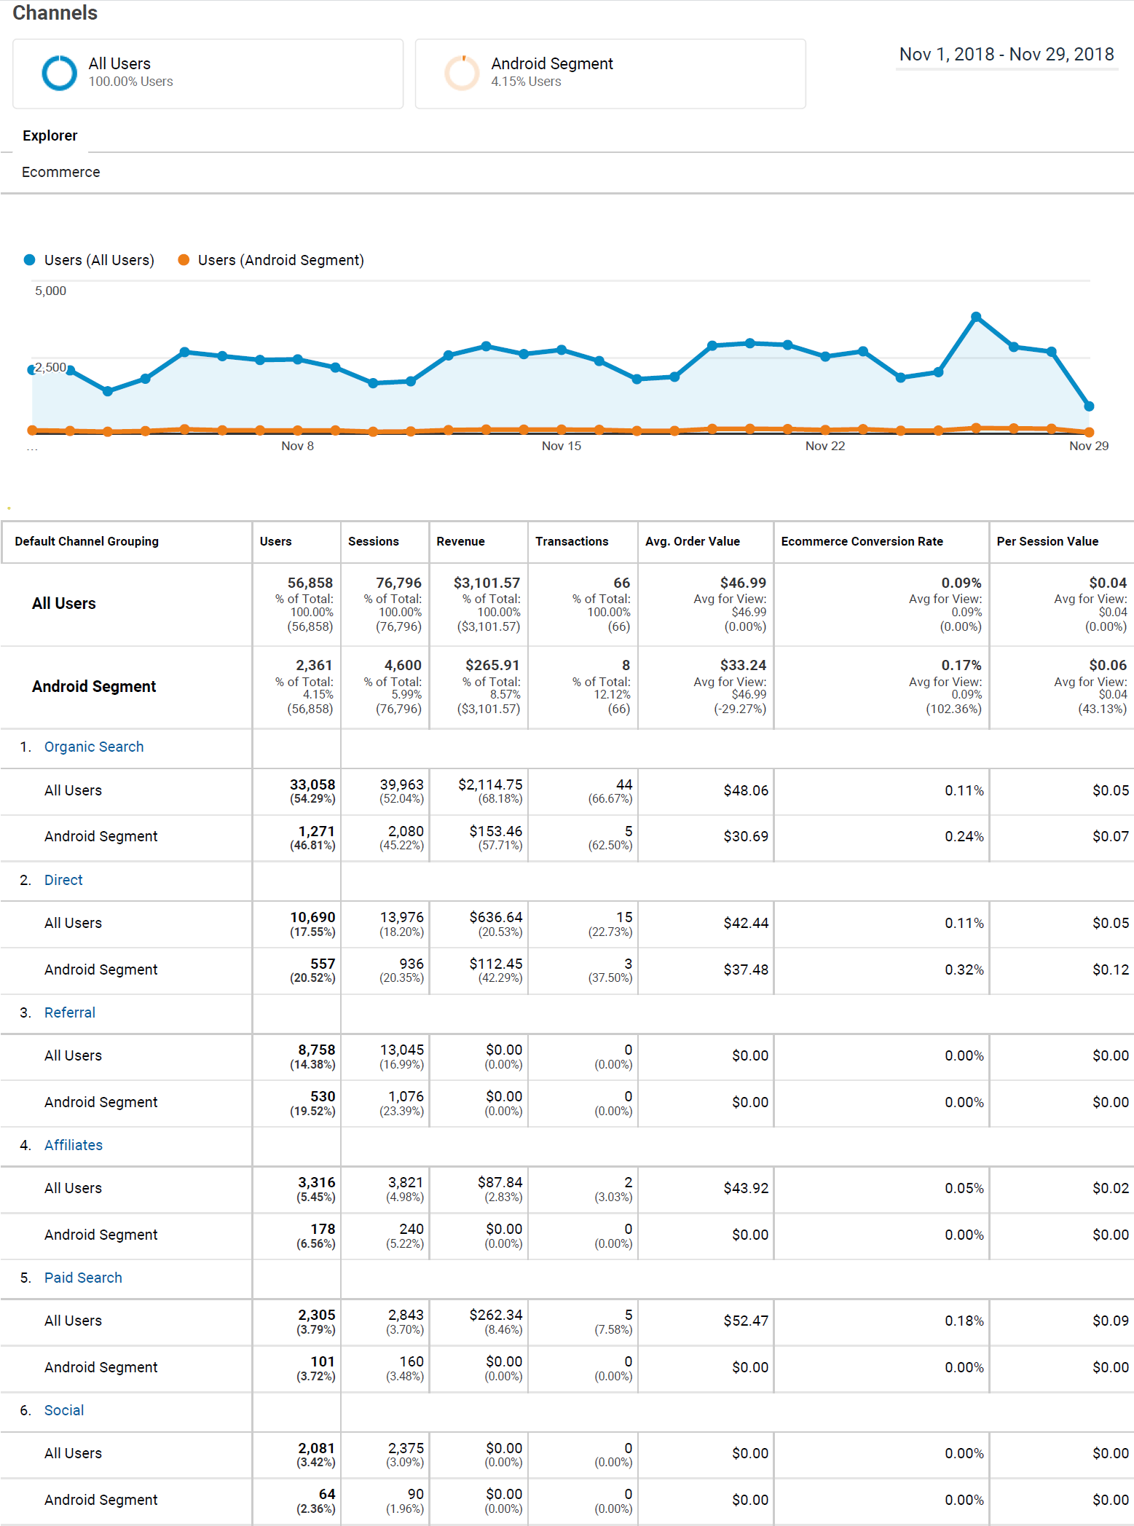
CAMPAIGN REPORT
Custom Channel acquisition report
Channels report, using a Custom Segment for users who had a landing page that contains "Android". Further filtered through the Ecommerce Conversion Rate for users brought in by the Paid Search channel.

Slide 25
THANK YOU

